Slide 1

IOT BASED HOME AUTOMATION
AAGOSH BANSAL
AMAY PHANSALKAR
Notes:
srijan

Slide 2

IOT
The Internet of Things (IoT) is the network of physical devices, vehicles, home appliances and other items embedded with electronics, software, sensors, actuators and connectivity which enables these objects to connect and exchange data.

Slide 3
ARDUINO
Arduino is an open source computer hardware and software company, project, and user community that designs and manufactures single-board microcontrollers and microcontroller kits for building digital devices and interactive objects that can sense and control objects in the physical and digital world.

Slide 4
TYPES OF ARDUINO BOARDS
Arduino MKR1000
Arduino Zero
Arduino Due
Arduino Yún
Arduino Leonardo
Arduino Uno
Arduino Mega2560
Arduino Ethernet
Arduino Nano
Arduino Pro
Here we are using Arduino mega 2560

Slide 5
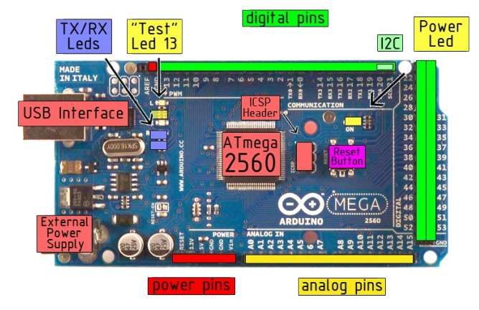
ARDUINO MEGA

Slide 6
PRORAMMING ENVIRONMENT
The Arduino integrated development environment(IDE) is a cross-platform application (for Windows, macOS, Linux) that is written in the programming language Java.
It includes a code editor with features such as text cutting and pasting, searching and replacing text, automatic indenting, brace matching, and syntax highlighting, and provides simple one-click mechanisms to compile and upload programs to an Arduino board
It also contains a message area, a text console, a toolbar with buttons for common functions and a hierarchy of operation menus.

Slide 7
A program written with the Arduino IDE is called a sketch.
Sketches are saved on the development computer as text files with the file extension .ino.
A minimal Arduino C/C++ program consist of only two functions:
setup(): This function is called once when a sketch starts after power-up or reset. It is used to initialize variables, input and output pin modes, and other libraries needed in the sketch.
loop(): After setup() has been called, function loop() is executed repeatedly in the main program. It controls the board until the board is powered off or is reset.

Slide 8
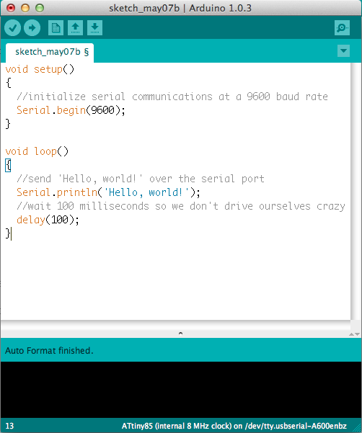

Slide 9
FEATURES
Operating Voltage 5V
Input Voltage (recommended) 7-12V
Input Voltage (limits) 6-20V
Digital I/O Pins 54 (of which 14 provide PWM output)
Analog Input Pins 16
DC Current per I/O Pin 40 mA
DC Current for 3.3V Pin 50 mA
Flash Memory 256 KB of which 8 KB used by bootloader
SRAM 8 KB
EEPROM 4 KB
Clock Speed 16 MHz

Slide 10
APPLICATIONS
Home automation
Sensor prototyping
Robotics
ISP programming
Easy wifi,bluetooth,ethernet,gsm connectivity

Slide 11
ADVANTAGES
Open source
Simplified and user friendly programming language
Portable
Low power consumption
Cost efficient

Slide 12
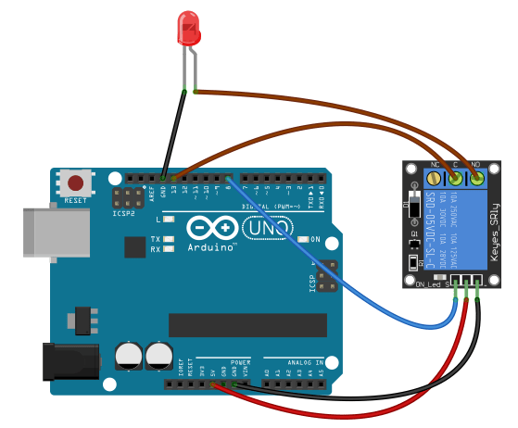

Slide 13
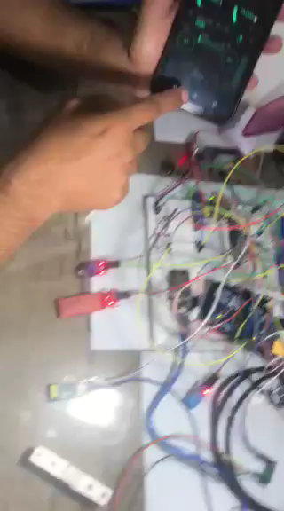

Slide 14
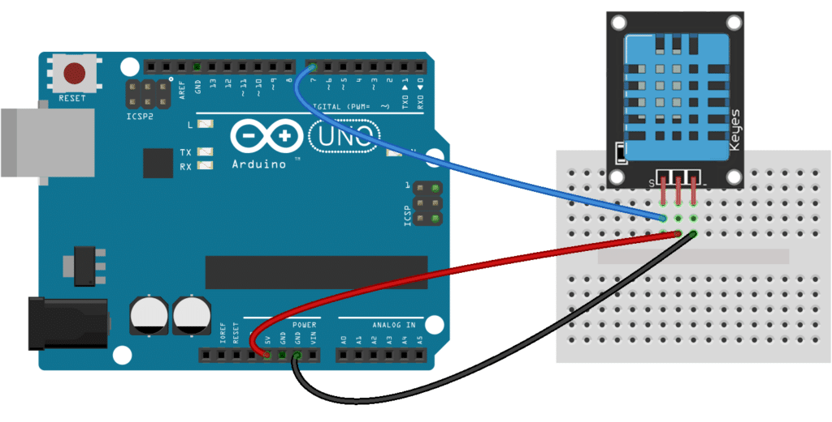

Slide 15
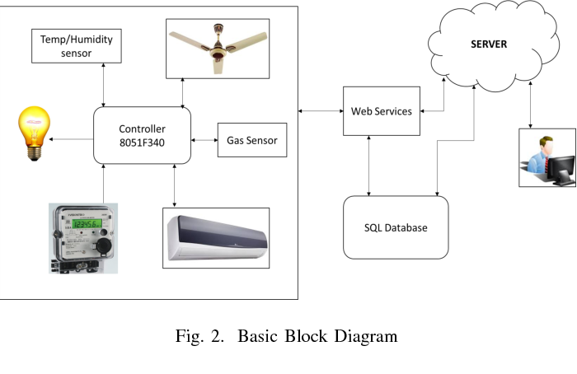

Slide 16
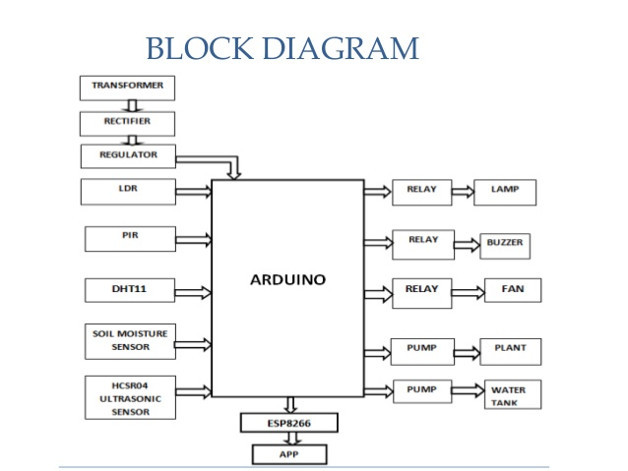

Slide 17
HOME AUTOMATION
The home automation system plays an important role in maintaining living standards and provide secure and flexible environment.
The aim of this project is to design a IOT based home automation system which makes operating of electrical appliances in home through android applications from anywhere in world using internet.
The home automation system allows controlling of home appliances by using voice commands by recognizing input speech.

Slide 18
WHY SMART HOME
In the metropolitan cities where the home has become a place to just dine and bed , hence increases the concern of the home owners about the safety and security of their homes when they are away.
In this corporate world it is quite difficult to monitor our dear ones such as infants or the aged members of the family.
In today’s busy lifestyle of people many a times they forget to switch off the various appliances which leads to unnecessary consumption of electrical energy along with the increase in electrical bills,ultimately resulting into climatic changes.
People who are disabled, handicapped or deaf can’t operate the appliances in the home or they can’t reach those things
Thus smart home automation provide an efficient soluion to overcome above problems.

Slide 19
